Slide 1
Topic 1-Extension

Slide 2
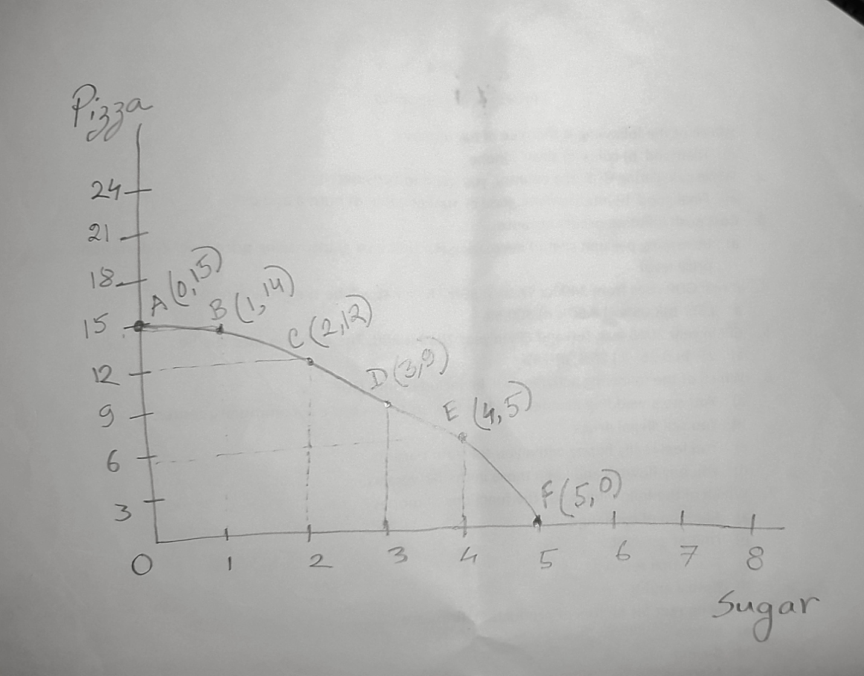
PPF(Production Possibility Frontier)

Slide 3
Shift/Rotate of PPF
If one of the factors of production(land/labor/capital) and technology changes, that we need to identify which of the products will change due to change in land /labor/capital
The question is whether the change in factor of production and technology will change only one good’s production or both of the goods’ production
That is why we have to identify whether the product is labor intensive or capital intensive or land intensive

Slide 4
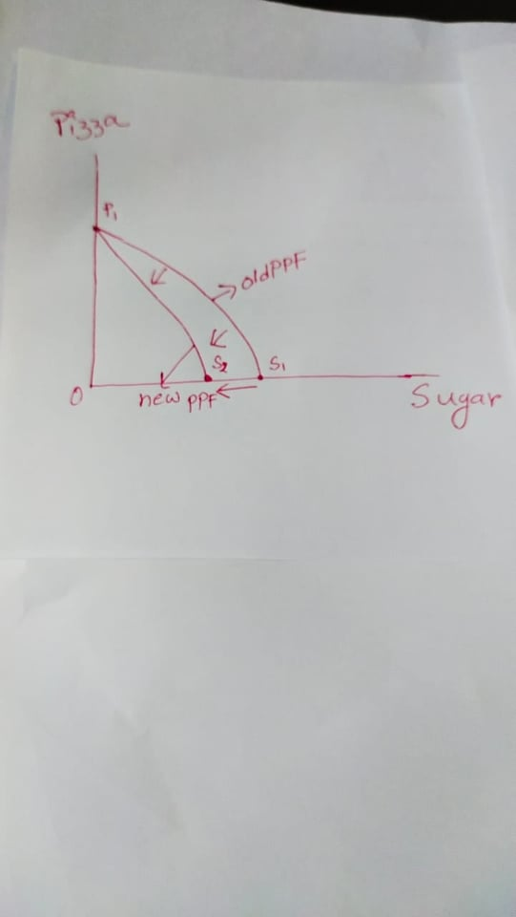
Case Study 1: For the previous example of sugar and pizza, assume that there is a labor strike in sugar industry, show this change in the PPF. Assume that, sugar is labor intensive and pizza is capital intensive
If labor strikes in sugar industry only and sugar is labor intensive, maximum amount of sugar production decreases, pizza production will remain unchanged. That is why PPF rotates inward.

Slide 5
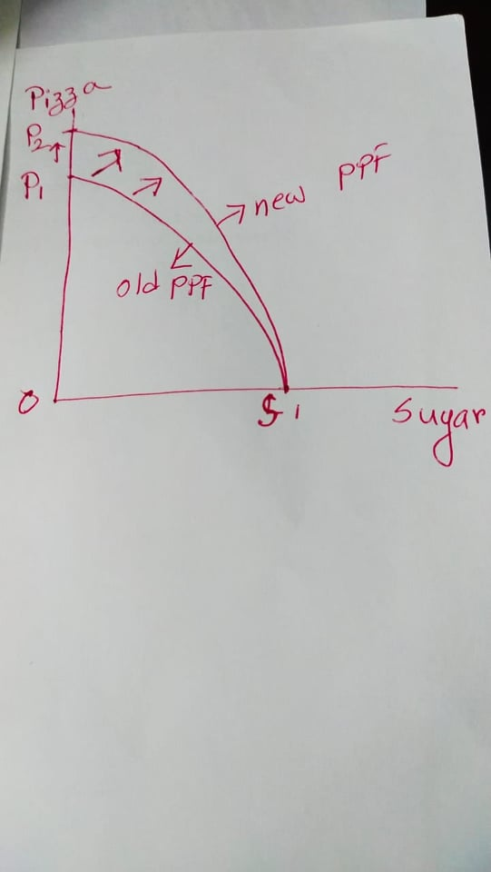
Case Study 2: For the previous example of sugar and pizza, assume that there is a new import of machines in pizza industry, show this change in the PPF. Assume that, sugar is labor intensive and pizza is capital intensive
If new machines are available in pizza industry (due to import) and pizza is capital intensive, maximum amount of pizza production increases, sugar production will remain unchanged. That is why PPF rotates outward.

Slide 6
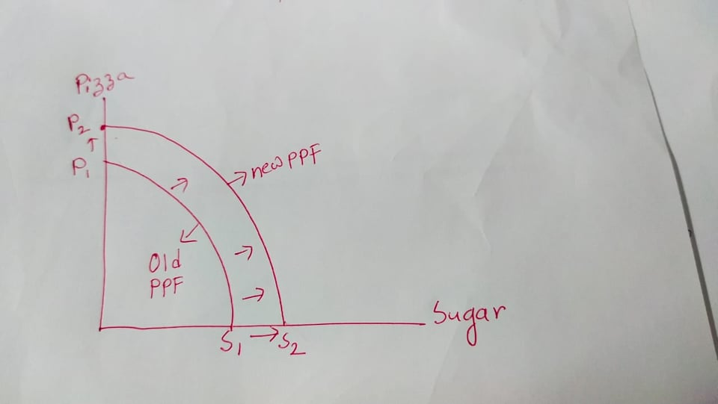
Case Study 3: For the previous example of sugar and pizza, assume that there is an increase in total population of that economy, show this change in the PPF. Assume that, sugar is labor intensive and pizza is capital intensive
Increase in total population means number of total workers will increase. These workers might work in both sugar and pizza sector. So maximum production of both products will increase which makes a PPF to outward parallel shift.

Slide 7
Case Study 4: For the previous example of sugar and pizza, assume that there is an upgrade of technology of that economy, show this change in the PPF. Assume that, sugar is labor intensive and pizza is capital intensive
Upgrade in technology means same number of land. Labor and capital can work with the help of much more better technology now. So maximum production of both products will increase which makes a PPF to outward parallel shift.

